Slide 1
GRACE BIBLE CHURCH
Women’s Bible Study
September 8, 2026

Slide 2
Course Overview
Week 1 - (Aug 25) Overview of covenants, why were they given and who are they for
Week 2 - (Sept 8) Adamic and Noahic Covenants
Week 3 - ( Sept 22) Abrahamic and Land Covenants
Week 4 - (Oct 6) Mosaic Covenant
Week 5 - (Oct 20) Davidic Covenant
Week 6 - (Nov 10) New Covenant

Slide 3
Adamic Covenant
The Adamic Covenant can be thought of in two parts: the Edenic Covenant (innocence) and the Adamic Covenant (grace). The Edenic Covenant is found in Genesis 1:26-30; 2:16-17. The Adamic Covenant is found in Genesis 3:16-19.

Slide 4
Edenic Covenant
Genesis 1:26-30, Then God said, “Let Us make man in Our image, according to Our likeness; and let them rule over the fish of the sea and over the birds of the sky and over the cattle and over all the earth, and over every creeping thing that creeps on the earth.” God created man in His own image, in the image of God He created him; male and female He created them. God blessed them; and God said to them, “Be fruitful and multiply, and fill the earth, and subdue it;

Slide 5
Edenic Covenant
and rule over the fish of the sea and over the birds of the sky and over every living thing that moves on the earth.” Then God said, “Behold, I have given you every plant yielding seed that is on the surface of all the earth, and every tree which has fruit yielding seed; it shall be food for you; and to every beast of the earth and to every bird of the sky and to every thing that moves on the earth which has life, I have given every green plant for food”; and it was so.

Slide 6
Edenic Covenant
Genesis 2:16-17, The Lord God commanded the man, saying, “From any tree of the garden you may eat freely; but from the tree of the knowledge of good and evil you shall not eat, for in the day that you eat from it you will surely die.”

Slide 7
What do we see in these two passages?
Mankind (male and female) created in God’s image.
Mankind’s dominion (rule) over the animal kingdom.
Divine directive for mankind to reproduce and inhabit the entire Earth.
Mankind to be vegetarian (eating of meat established in the Noahic covenant: Genesis 9:3).
Eating the fruit of the tree of the knowledge of good and evil was forbidden (with death as the stated penalty).

Slide 8
The Adamic Covenant
Genesis 3:16-19, To the woman He said, “I will greatly multiply your pain in childbirth, in pain you will bring forth children; Yet your desire will be for your husband, and he will rule over you.” Then to Adam He said, “Because you have listened to the voice of your wife, and have eaten from the tree about which I commanded you, saying, ‘You shall not eat from it’; Cursed is the ground because of you; In toil you will eat of it all the days of your life.

Slide 9
The Adamic Covenant
Both thorns and thistles it shall grow for you; And you will eat the plants of the field; By the sweat of your face you will eat bread, till you return to the ground, because from it you were taken; For you are dust, and to dust you shall return.”

Slide 10
As the result of Adam’s sin, the following curses were pronounced:
Enmity between Satan and Eve and her descendants
Painful childbirth for women
Marital strife
The soil cursed
Introduction of thorns and thistles
Survival to be a struggle
Death introduced
Death will be inescapable for all living things

Slide 11
Although these curses are severe and inescapable, a wonderful promise of grace was also included in the Adamic Covenant.
Genesis 3:15 is often referred to as the “Proto-Gospel” or “Protoevangelium”, what is known as the: “First Gospel.”
Speaking to Satan, God says, “And I will put enmity between you and the woman, / And between your seed and her seed; / He shall bruise you on the head, / And you shall bruise him on the heel.”

Slide 12
Here God promises that one born of a woman would be wounded in the process of destroying Satan.
The “seed” of the woman who would crush the Serpent’s head is none other than Jesus Christ (see Galatians 4:4 and 1 John 3:8).
Even in the midst of the curse, God’s gracious provision of salvation shines through.

Slide 13
Adam is a type of Christ
He is a son of God (direct creation of God) Luke 3:38
Adam was not deceived, he took the forbidden fruit because He loved Eve and chose to suffer with her 1 Timothy 2:14
He prefigures Christ who was to come Romans 5:14
He was the means of salvation for Eve (took on sin or made sin for her) (As Christ did for us, 2 Cor 5:21)
The redeemer had to be a kinsman redeemer, Revelation 5
As Eve was to Adam, the Church is the bride of Christ Isaiah 62:5, 2 Cor 11:2, Revelation 21:2,22:17

Slide 14
Q - What did Adam and Eve give up for the fruit?
Q - What reasons have you heard in the past for why Adam ate the fruit?
Q - How does understanding Adam’s decision make you think about Jesus giving His life for us?

Slide 15
The Noahic Covenant
Genesis 9:8-17
Then God spoke to Noah and to his sons with him, saying, “Now behold, I Myself do establish My covenant with you, and with your descendants after you; and with every living creature that is with you, the birds, the cattle, and every beast of the earth with you; of all that comes out of the ark, even every beast of the earth. I establish My covenant with you; and all flesh shall never again be cut off by the water of the flood, neither shall there again be a flood to destroy the earth.”

Slide 16
The Noahic Covenant
God said, “This is the sign of the covenant which I am making between Me and you and every living creature that is with you, for all successive generations; I set My bow in the cloud, and it shall be for a sign of a covenant between Me and the earth. It shall come about, when I bring a cloud over the earth, that the bow will be seen in the cloud, and I will remember My covenant, which is between Me and you and every living creature of all flesh; and never again shall the water become a flood to destroy all flesh. When the bow is in the cloud, then I will look upon it, to remember the everlasting covenant between God and every living creature of all flesh that is on the earth.” And God said to Noah, “This is the sign of the covenant which I have established between Me and all flesh that is on the earth.”

Slide 17
The Noahic Covenant, is the promise that God made to Noah, his descendants, and really the entire world, after the world wide flood. The Noahic Covenant has several distinguishing features.
First, it is an unconditional covenant
Second, it was made to Noah and all his descendants as well as “every living creature” and the earth in general (Genesis 9:8-10)
Third, it was sealed with a sign, the rainbow

Slide 18
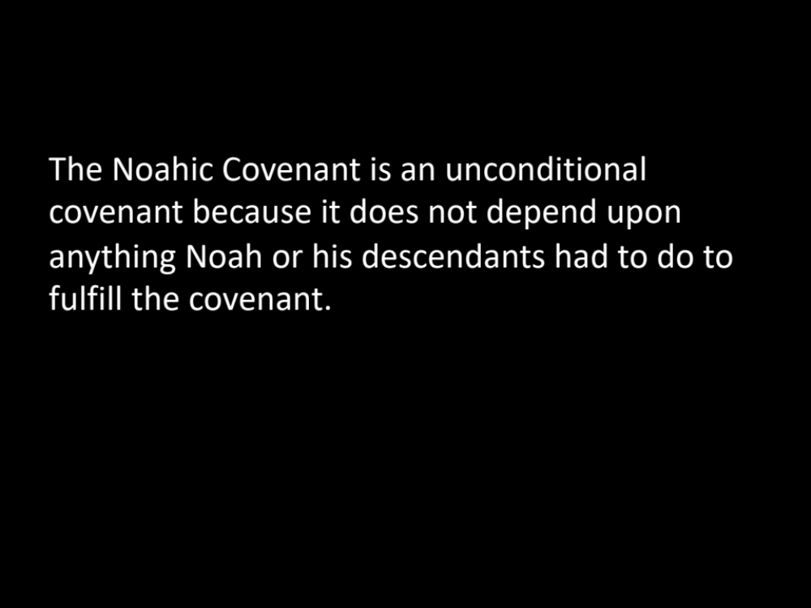
The Noahic Covenant is an unconditional covenant because it does not depend upon anything Noah or his descendants had to do to fulfill the covenant.

Slide 19
The promise is based upon God’s faithfulness alone
Because of God’s faithfulness to always do what He says He will do, we can know today with certainty that there will never be another worldwide flood as there was in the days of Noah, no matter how wicked mankind becomes
Neither the wickedness of mankind, nor their righteousness, will change this unconditional covenant

Slide 20
There is no "condition" under which God will renege on His promise
This does not mean that God will never again destroy the earth, however. He has promised to one day destroy the earth by fire (2 Peter 3:10, 11; Revelation 20:9, 21:1 ) in the terrible events known as the “day of the Lord.”

Slide 21
After the flood God promised that He would never again send a worldwide flood to destroy the earth as an act of His divine judgment for sin.

Slide 22
As a sign to remind Noah and his descendants of His covenantal promise, God “set the rainbow in the cloud”
Genesis 9:12-13, God said, “This is the sign of the covenant which I am making between Me and you and every living creature that is with you, for all successive generations; I set My bow in the cloud, and it shall be for a sign of a covenant between Me and the earth.
Just as circumcision was the sign of the Abrahamic Covenant, the rainbow is the sign of the Noahic Covenant

Slide 23
When we see a rainbow we should always be reminded of God’s faithfulness and His amazing grace
We should also be reminded that our God is a holy and righteous God who has a holy hatred for sin and who will not allow sin to go unpunished forever
Just as God provided a way for Noah and his family to be saved in the ark, He also has provided a way for us to be saved through Jesus Christ
Noah and his family were saved from the wrath of God that came in the flood, just as those who are in Christ are saved from the “wrath to come” (1 Thessalonians 1:10).

Slide 24
Q-Why do you think Satan has taken over the rainbow?
Q-When God makes a promise it is irrevocable. How does this impact you?
Q-How might our family or friends who don’t know Jesus respond to God being a God who keeps His promises

